Slide 1
Flux of Souls

Slide 2
Roles
Rudy Caliph – Scrum Master
Craig Rose – Developer
Randy Peacock – Developer
Richard Andrews – Developer
Stephan Dos Santos – Developer
Tobias Perez Davidson– Developer

Slide 3
Overview
Game Description
Machinations Tool Demo
Software and Version Control
Pivotal Tracker Breakdown
Design/Analysis
Current Project State
Q/A

Slide 4
Game Description
Concept & Problem Statement
Gameplay
Machinations Tool Demo

Slide 5
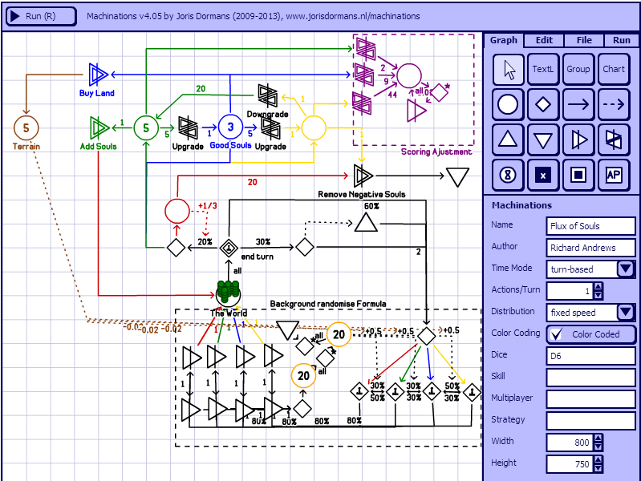
Machinations Tool Demo
http://www.jorisdormans.nl/machinations/wiki/index.php?title=Machinations_Tool

Slide 6
Software and Version Control
Xna C# Programming platform
Git Hub Code Repository
High Level Architecture

Slide 7
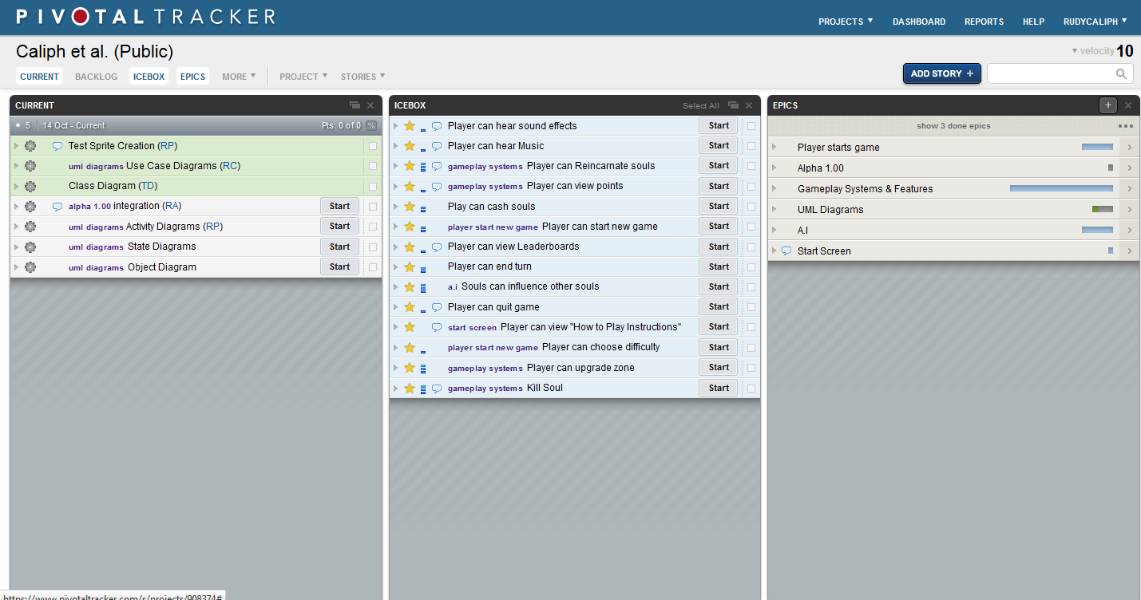
Pivotal Tracker
https://www.pivotaltracker.com/s/projects/908374

Slide 8
Design And Analysis
Class Diagram
Use Case Diagram

Slide 9
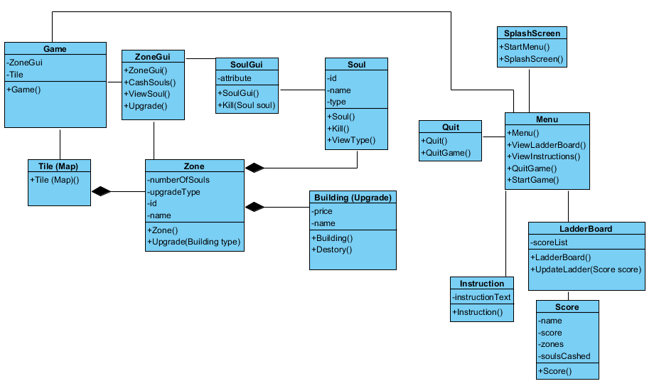
Class Diagram

Slide 10
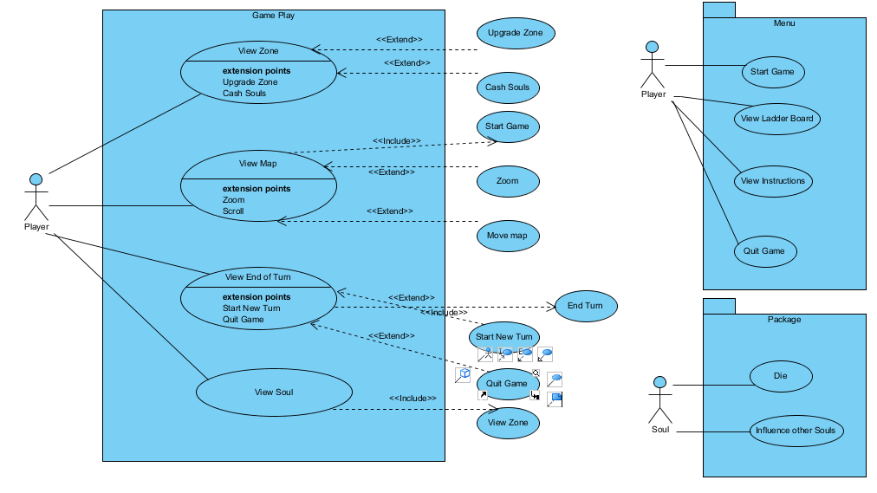
USE Case diagrams

Slide 11
Current status of the Project
Map Tiling - Complete
Zoom Functions – Complete
Splash Screen – Complete
Player Control Layout – Complete
Use Case / Class Diagrams – Complete
Current Integration – In Progress

Slide 12
Question / Answer
Any questions about the project?

